Slide 1
Dumbways Bootcamp DevOps
Week 1
Asep Saepul Rohman

Slide 2
CONTENTS
Task Week 1:
VM-Install Ubuntu
VM-Setup Network
VM-Install Application

Slide 3
VM
Install Ubuntu

Slide 4
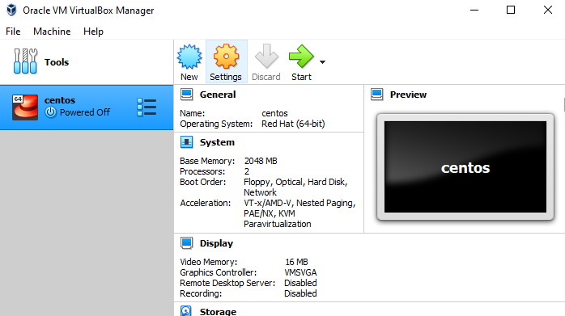
Install Ubuntu

Slide 5
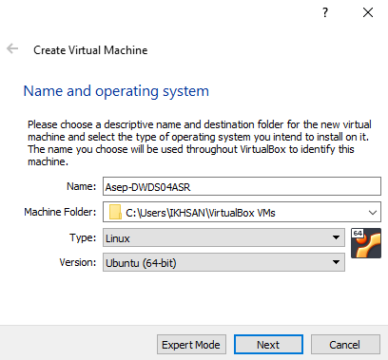
Install Ubuntu

Slide 6
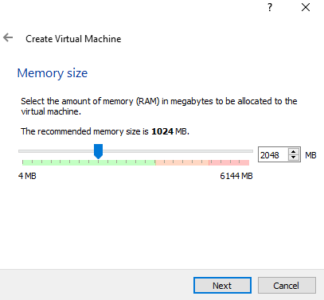
Install Ubuntu

Slide 7
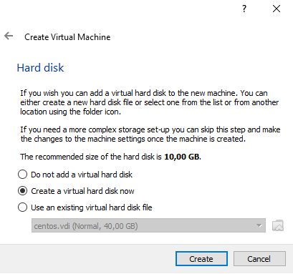
Install Ubuntu

Slide 8
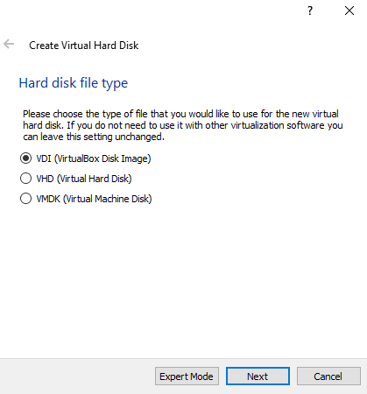
Install Ubuntu

Slide 9
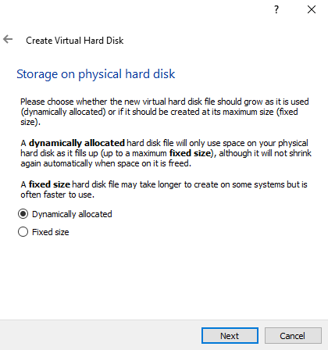
Install Ubuntu

Slide 10
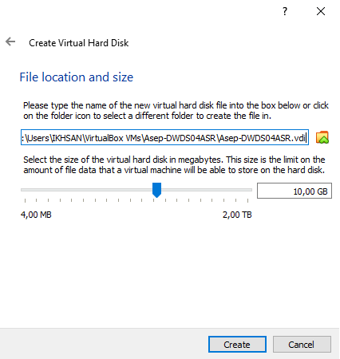
Install Ubuntu

Slide 11
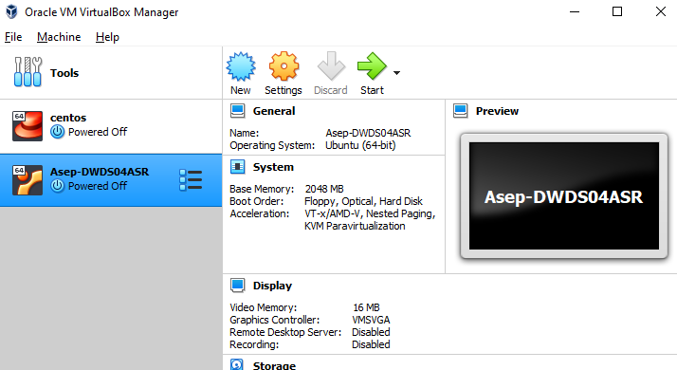
Install Ubuntu

Slide 12
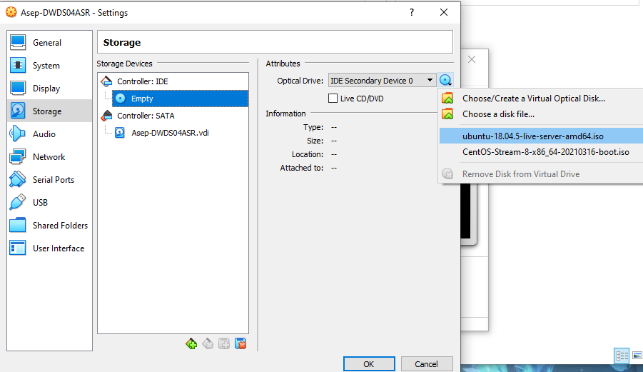
Install Ubuntu

Slide 13
Install Ubuntu

Slide 14
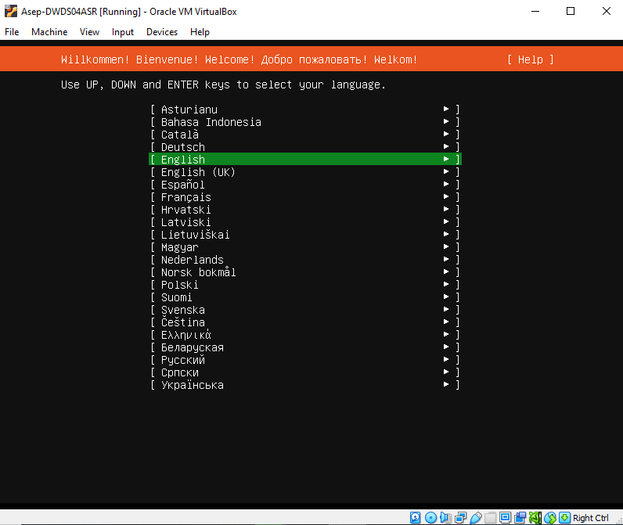
Install Ubuntu

Slide 15
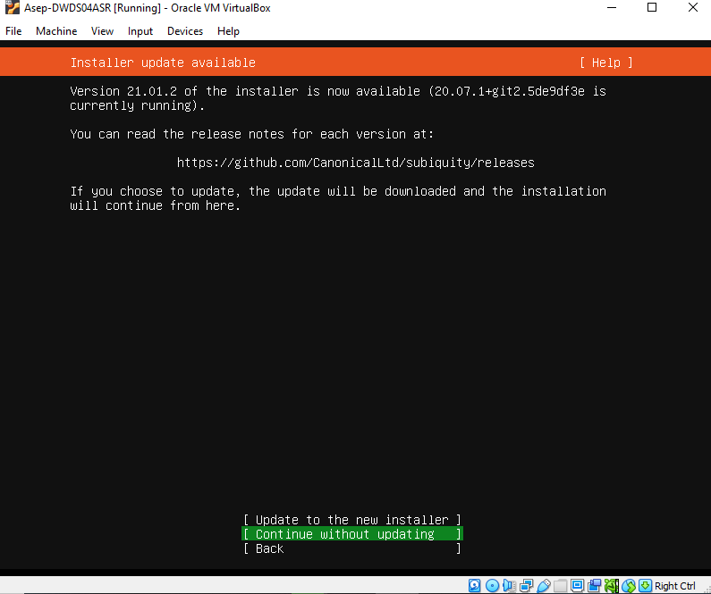
Install Ubuntu

Slide 16
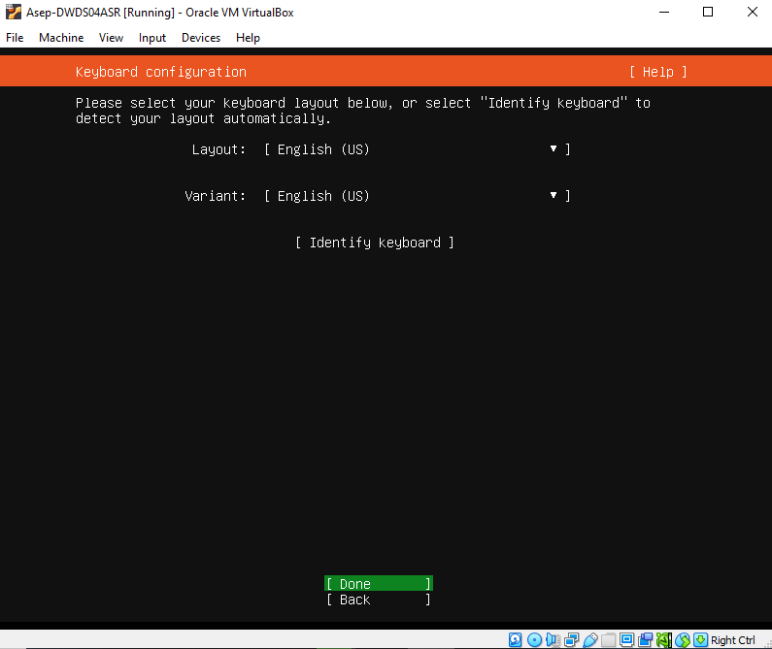
Install Ubuntu

Slide 17
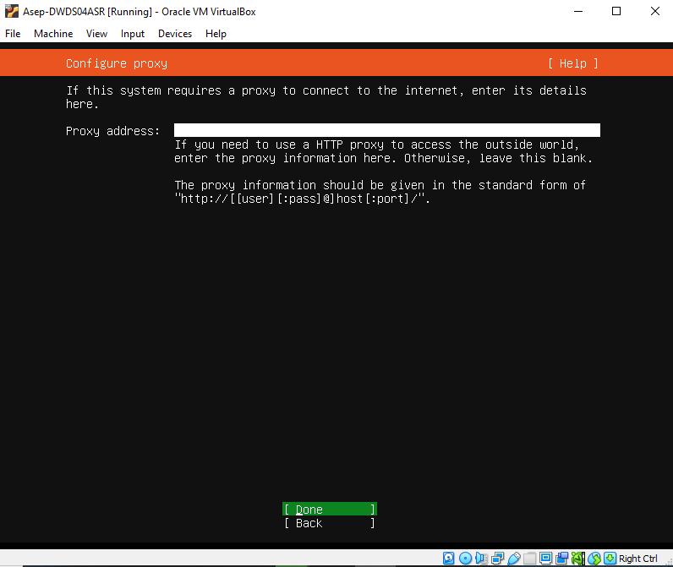
Install Ubuntu

Slide 18
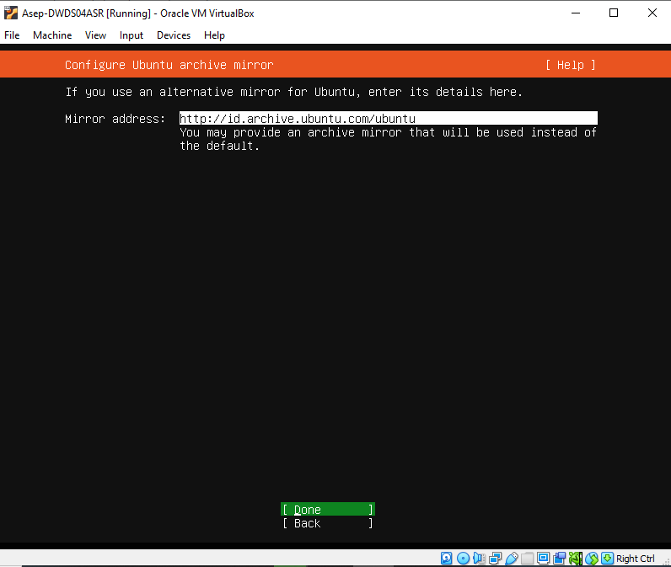
Install Ubuntu

Slide 19
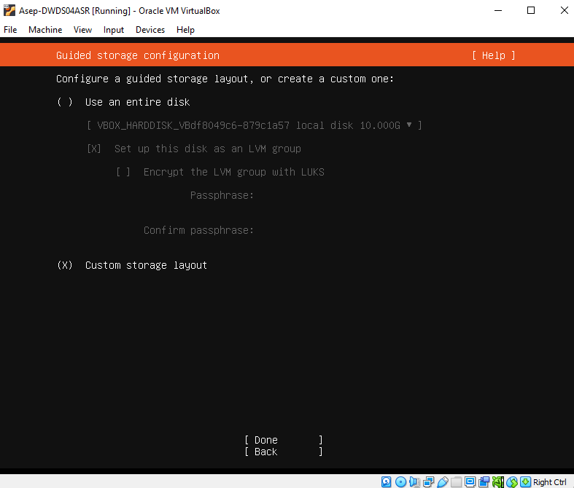
Install Ubuntu

Slide 20
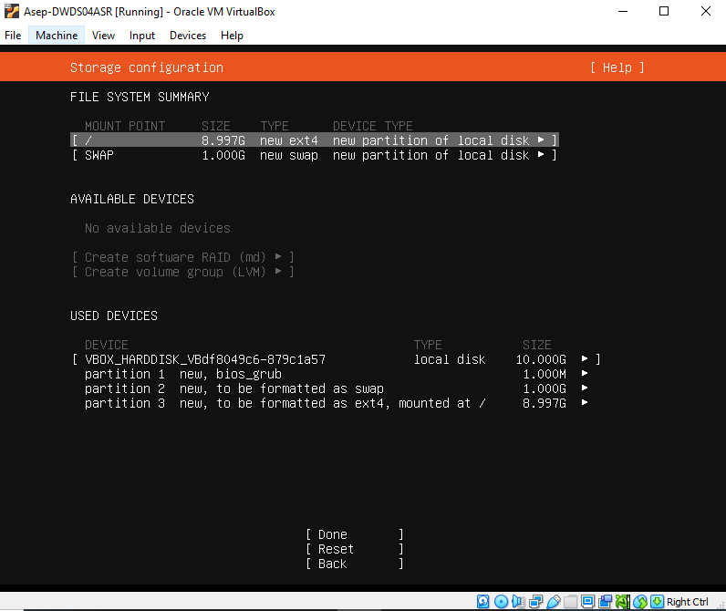
Install Ubuntu

Slide 21
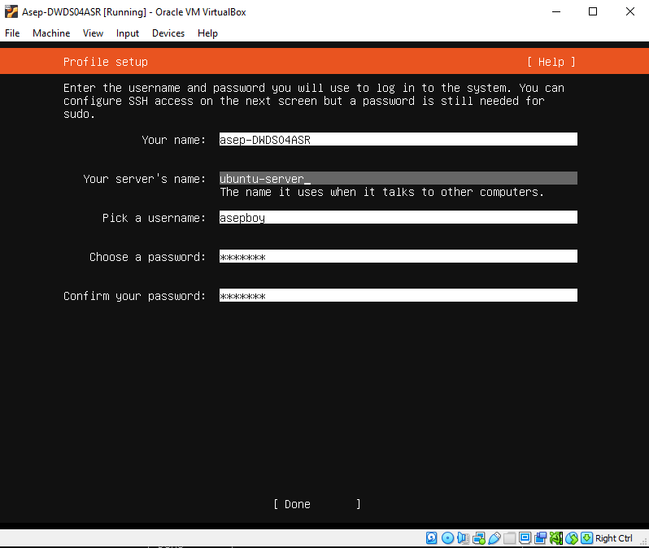
Install Ubuntu

Slide 22
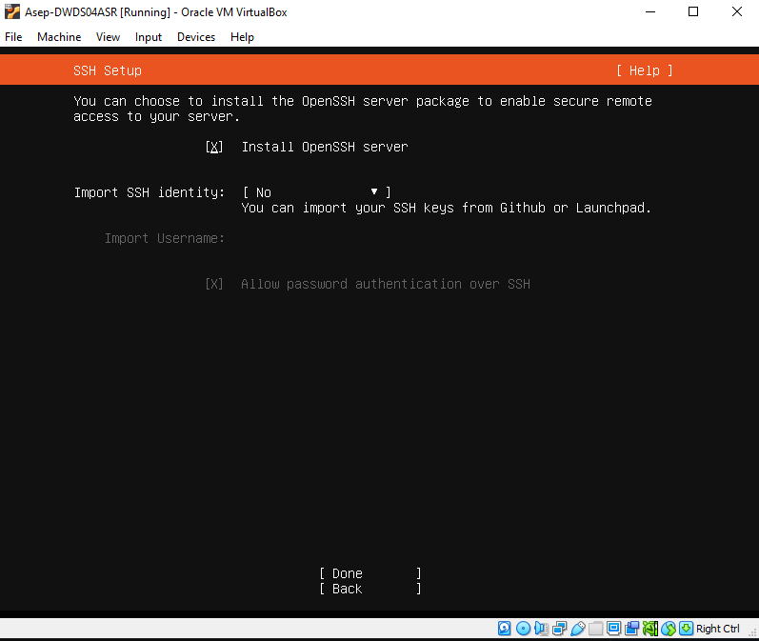
Install Ubuntu

Slide 23
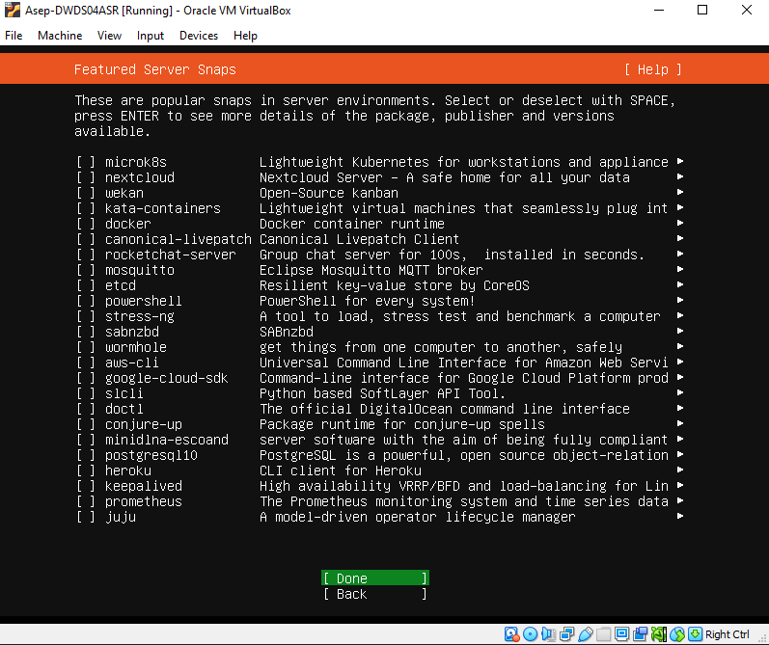
Install Ubuntu

Slide 24
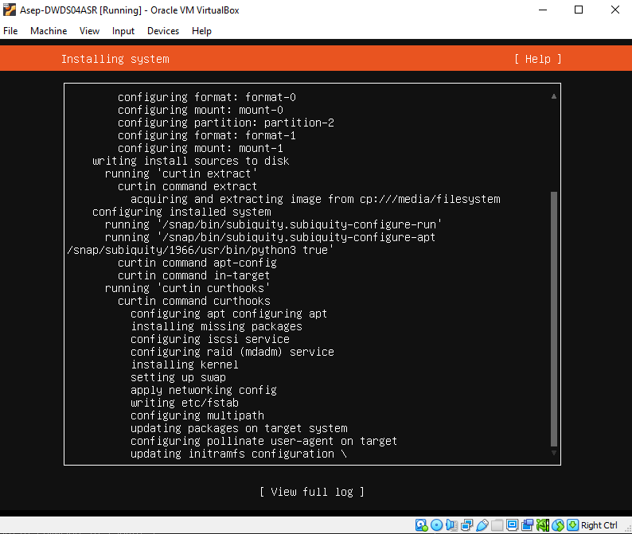
Install Ubuntu

Slide 25
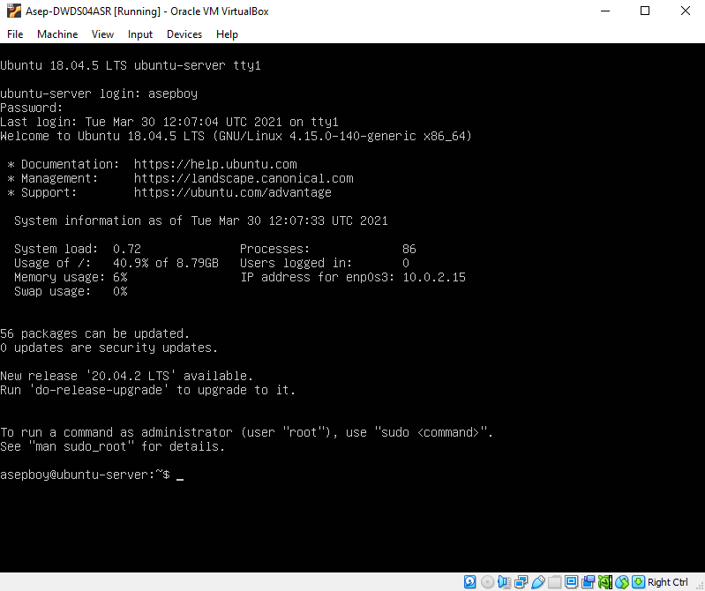
Install Ubuntu

Slide 26
VM
Setup Network

Slide 27
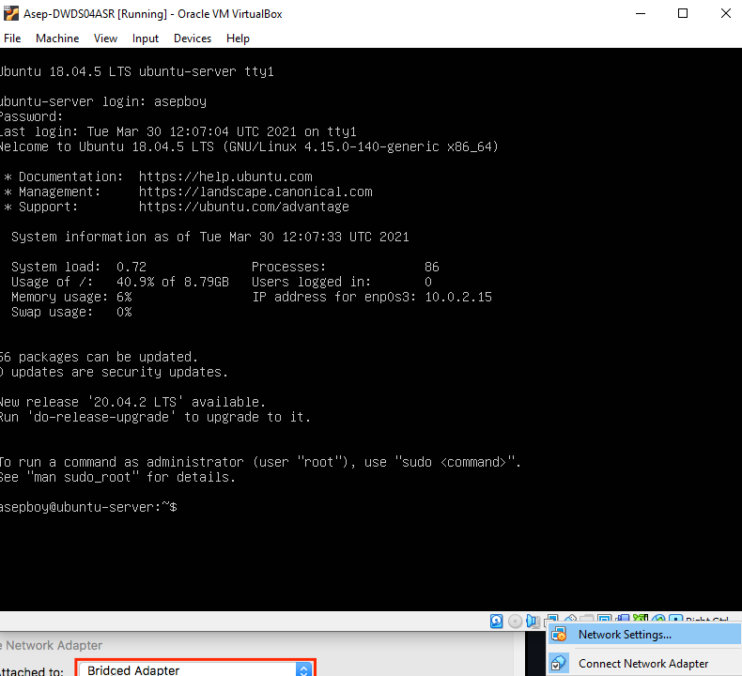
Setup Network

Slide 28
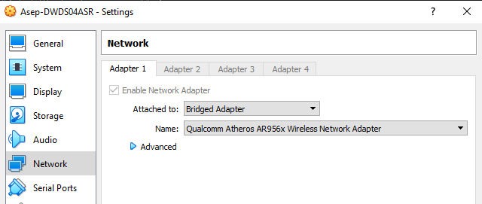
Setup Network

Slide 29
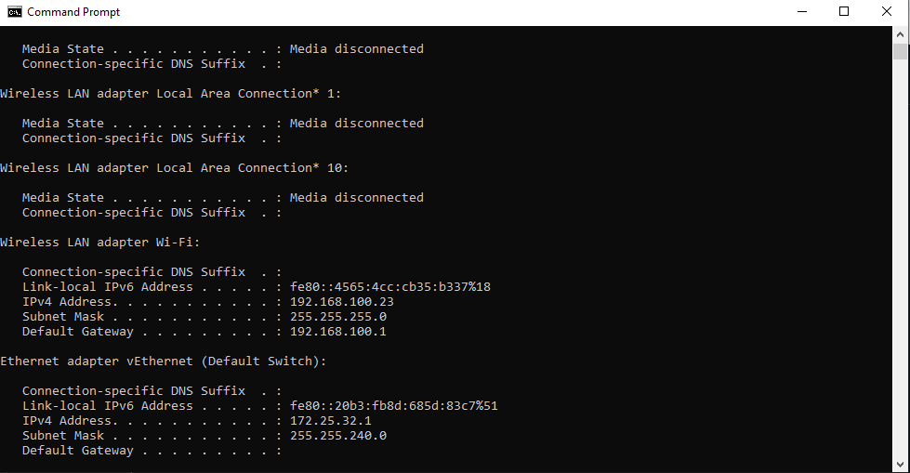
Setup Network

Slide 30
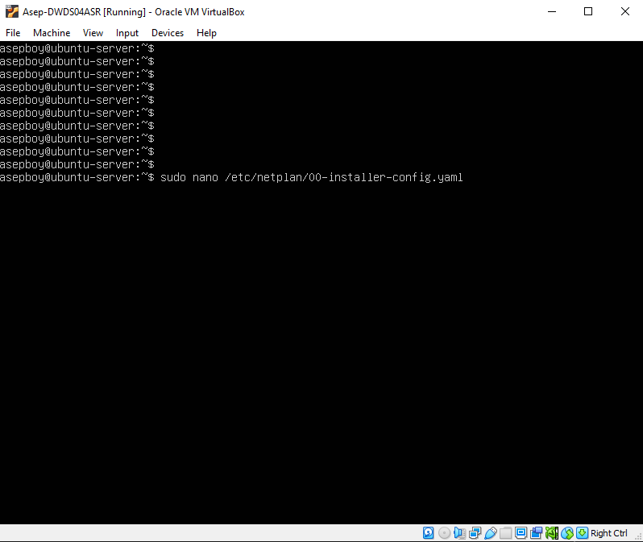
Setup Network

Slide 31
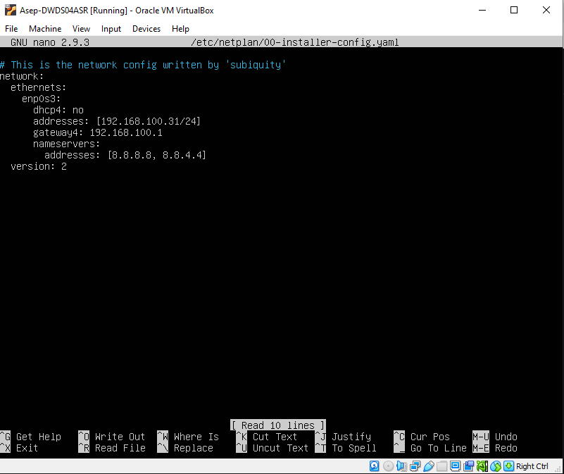
Setup Network

Slide 32
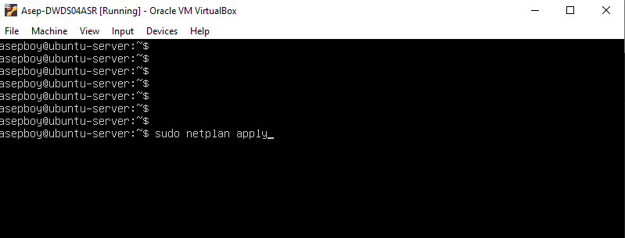
Setup Network

Slide 33
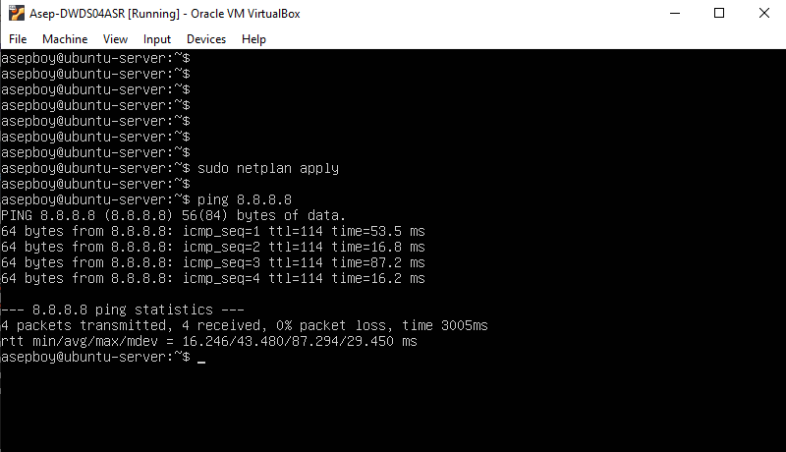
Setup Network

Slide 34
VM
Install Application

Slide 35
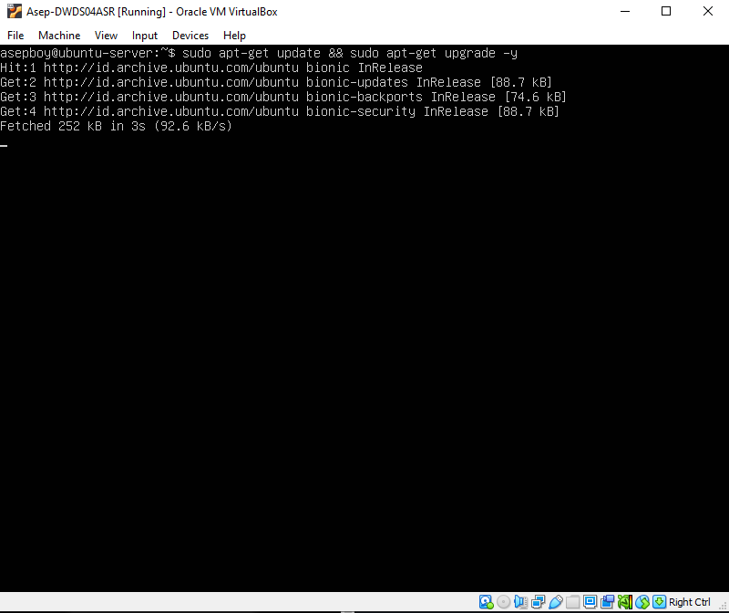
Install Application

Slide 36
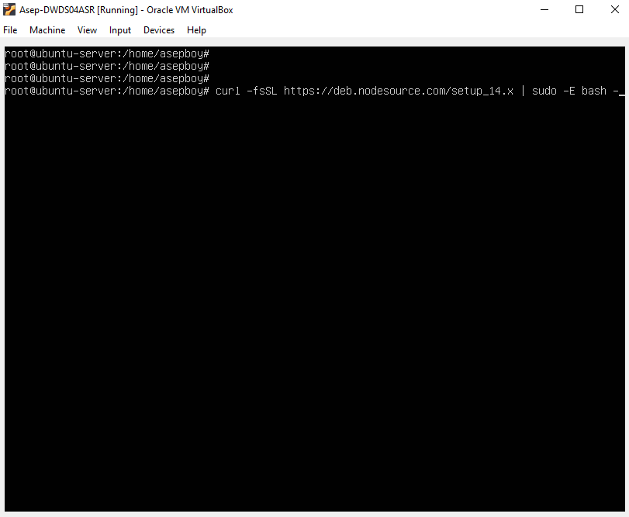
Install Application

Slide 37
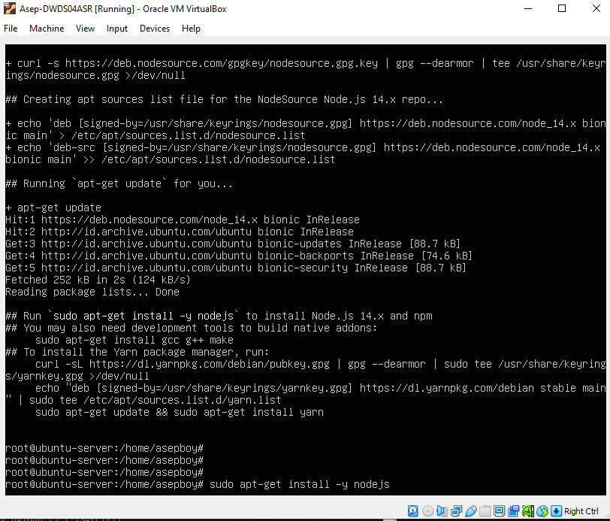
Install Application

Slide 38
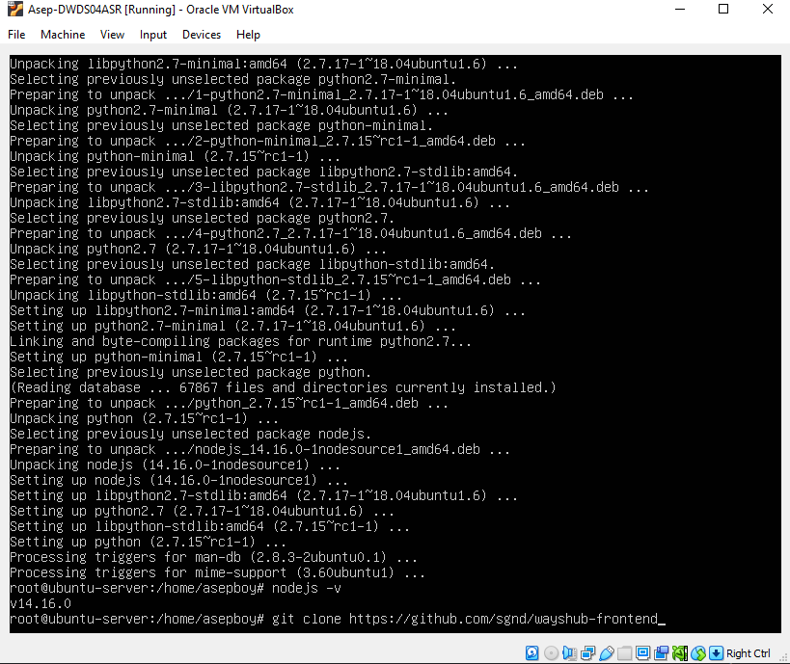
Install Application

Slide 39
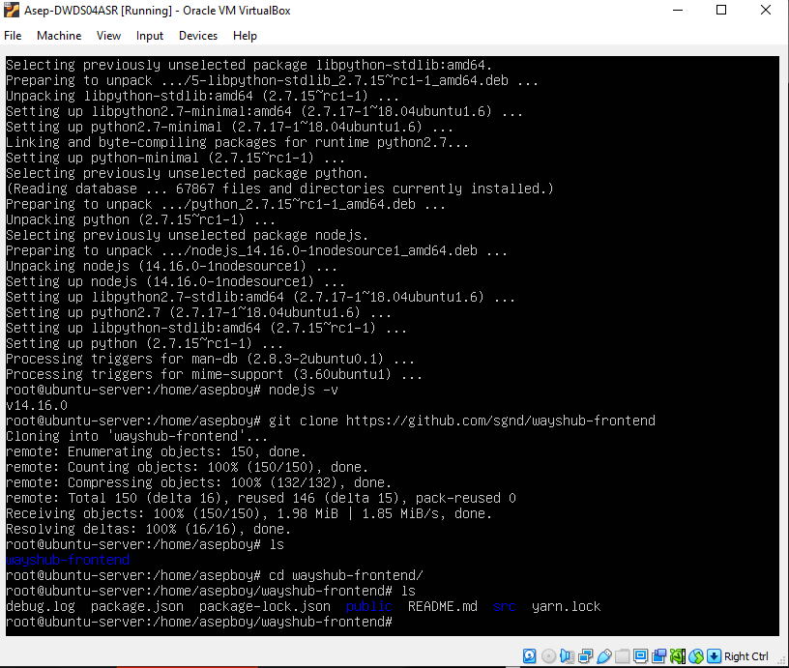
Install Application

Slide 40
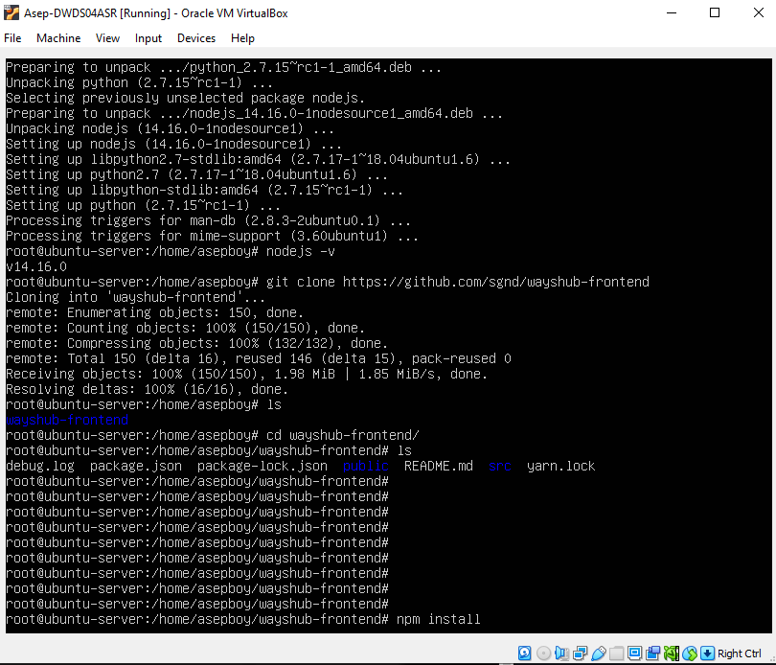
Install Application

Slide 41
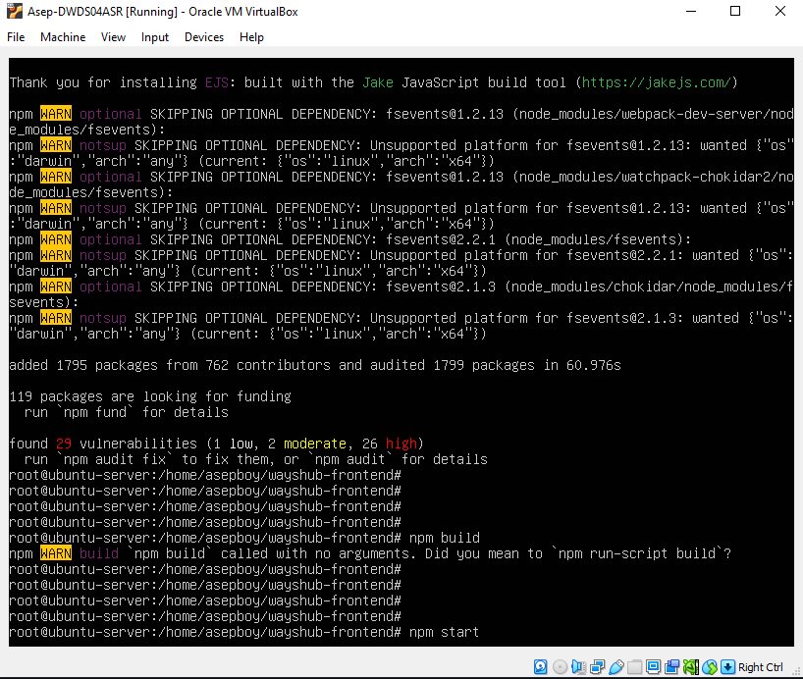
Install Application

Slide 42
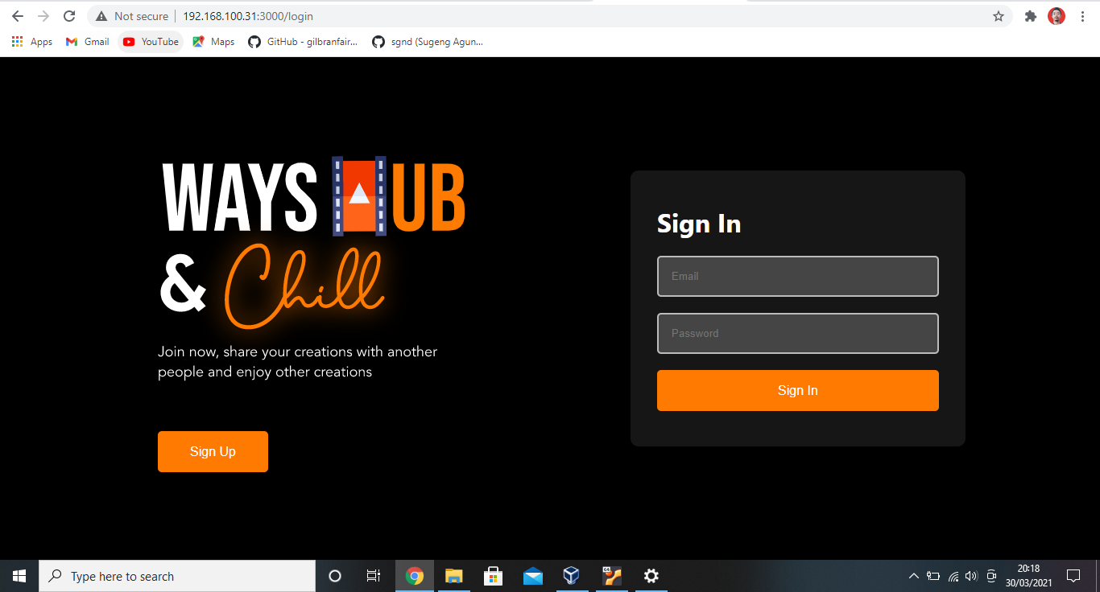
Install Application

